Slide 1
Event Study:
Dividend Increase
Group: SMRMJ
GAO Jun 120090240
LIU Xinyu 120020128
MA Kexuan 120090651
SHEN Hengyu 120090633
ZHANG Haoshen 120090798

Slide 2
Content
Introduction
Data visualization
Generate normal return
Conclusion & Discussion
Content
Introduction
Generate normal return
Data visualization
Conclusion & Discussion
Notes:
Offsetting 和Engaging 再确认一下

Slide 3
PART 1 INTRODUCTION

Slide 4
Introduction: Dividend Increase----Explanation
What is the event----Dividend Increase?
A dividend is the distribution of a company's earnings to its shareholders and is determined by the company's board of directors.
Why Dividend Increase can affect the stock price?
For investor:
Dividend volume and consistency reflect the company’s finance situation
For company:
An increase in the company's net profits out of which dividends are paid.
A shift in the company’s growth strategy.
Content
Introduction
Generate normal return
Data visualization
Conclusion & Discussion

Slide 5
Introduction: Dividend Increase---- Target Company
PERMNO | AR | Day | Headline
89413 | 0.436798 | 1 | Big 5 Sporting Goods Corp. Reports Sales Results for the Fourth Quarter and Full Year 2010; Revised Earnings Guidance for the Fourth Quarter of 2010 ; Provides Earnings Guidance for the Full Year of 2010.
34948 | 0.317404 | 1 | Oxford Industries Inc. Reports Earnings Results for the Second Quarter and Six Months Ended December 1, 2006; Revised Earnings Guidance for the Full Year Ending June 1, 2007; Provides Earnings Guidance for the Third Quarter and Fourth Quarter of Fiscal 2007; Declares Quarterly Dividend Payable on March 2, 2007.
38703 | 0.163343 | 0 | Wells Fargo & Company Revised Earnings Outlook for Fourth Quarter of 2008.
16555 | 0.298460 | 1 | Universal Corp. Increases Earnings Expectations For Fiscal Year End On June 30, 2002.
81665 | 0.285396 | 1 | Systemax Inc. Declares Quarterly Cash Dividend, Payable on May 22, 2017.
89715 | 0.275645 | 0 | Imperial Sugar Co. Declares Increased Quarterly Dividend Payable on February 24, 2006.
86827 | 0.288230 | 1 | Heidrick & Struggles International, Inc. Declares Cash Dividend For the First Quarter of Year 2019, Payable on March 22, 2019.
20336 | 0.271923 | 0 | North & Webster, LLC made an offer to acquire additional majority stake in CSP Inc. (NasdaqGM:CSPI) from Samuel A. Kidston and other sellers..
93305 | 0.270775 | 1 | Financial Engines, Inc. has filed a Follow-on Equity Offering.
90248 | 0.255799 | 0 | Dominos Pizza Inc. Reports Earnings Results for the Half Year of Fiscal 2007 ; Revised Earnings Guidance for the Full Year of Fiscal 2007 ; Declares Final Dividend.
Content
Introduction
Generate normal return
Data visualization
Conclusion & Discussion

Slide 6
Introduction: Dividend Increase----Our expectation
Short-term Reaction
Price
Cash Flow
Systematic
Risk
Confidence
-
-
-
+
Long-term Reaction
Price
Cash Flow
Systematic
Risk
Confidence
+
+
-
+
Content
Introduction
Generate normal return
Data visualization
Conclusion & Discussion

Slide 7
Introduction: Dividend Increase----Literature
Profitability: Poterba and Summers’s dividend signaling theory
A company's announcement of an increase in dividend payouts is an indication of positive future prospects.
Non-profitability: Gustavo in 2014
For dividend increasing firms, their systematic risk significantly declines around the decision to increase dividends.
Content
Introduction
Generate normal return
Data visualization
Conclusion & Discussion

Slide 8
PART 2
Generate normal return

Slide 9
Generate normal return----Basic Information
Market Model & Fama-French 3 Factor Model
Normal Return (-230,- 30)
Estimation period = 200
Gap period
Event window
t=-230
t=-30
t=-5
t=0
t=5
Content
Introduction
Generate normal return
Data visualization
Conclusion & Discussion

Slide 10
Generate normal return----Threshold for Regression
Most companies have datapoint equal to 200 but some companies have missing datapoint.
01. PERMNO = 11285
• Datapoint < 120
• event day is 2022-02-07 , but our data only cover up to the 2022-3-31
02. PERMNO = 13035
• Datapoint < 120
• Listed on 2011-11-28 and event day is 2011-11-28
Content
Introduction
Generate normal return
Data visualization
Conclusion & Discussion

Slide 11
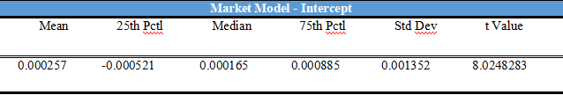
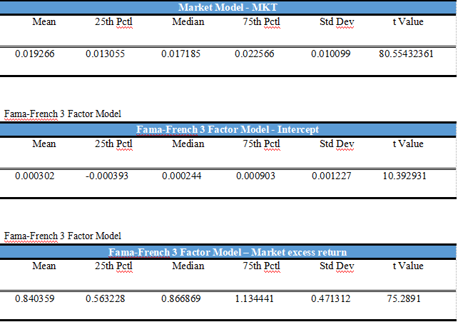
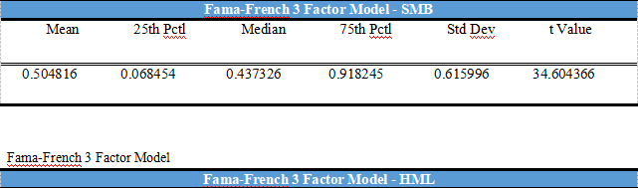

Generate normal return----Coefficient Table
Content
Introduction
Generate normal return
Data visualization
Conclusion & Discussion

Slide 12
PART 3
Data visualization

Slide 13
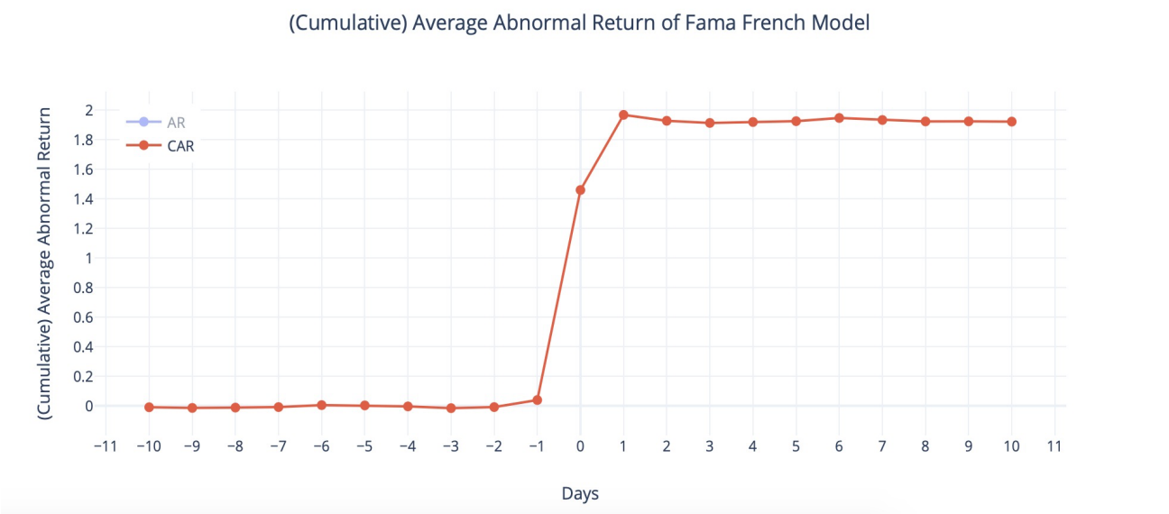
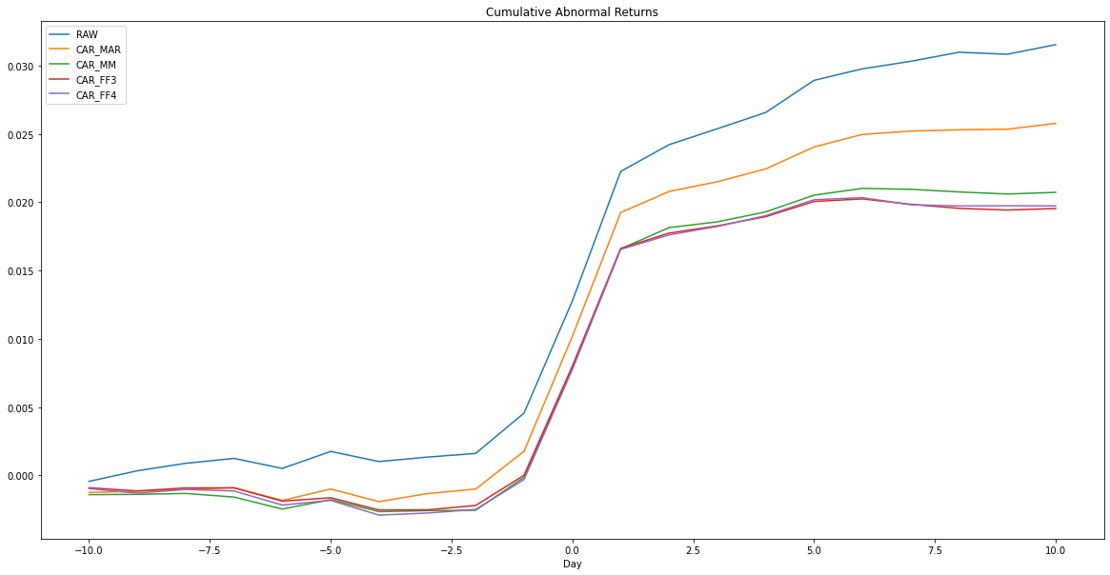
Data visualization---- Average CAR Line Chart
Content
Introduction
Generate normal return
Data visualization
Conclusion & Discussion

Slide 14
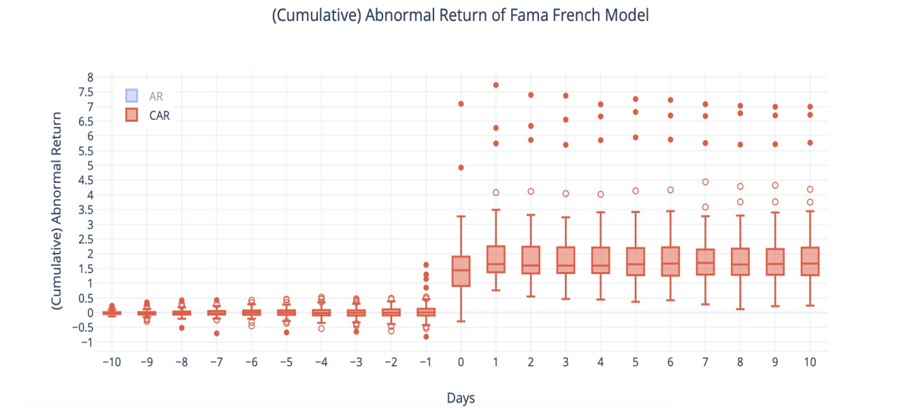
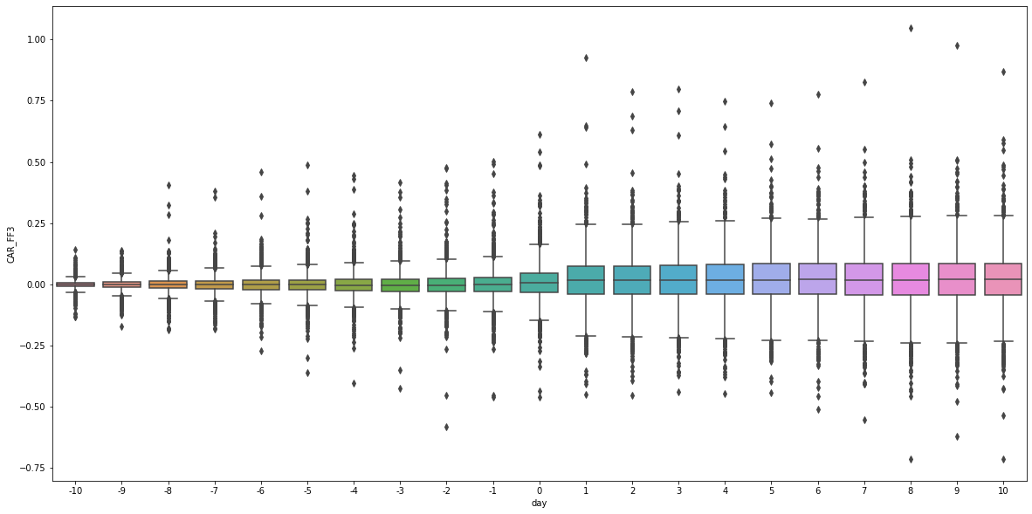
Data visualization---- CAR Boxplot
Content
Introduction
Generate normal return
Data visualization
Conclusion & Discussion

Slide 15
International Overview
Data visualization---- Outliers
Keurig Green Mountain Coffee (PERMNO: 79588)
Went private by JAB for $13.9B in December 2015. JAB Holding Company announced that they acquired the company in $92.00 in cash.
Keynote System Inc. (PERMNO: 87242)
Being acquired by Thoma Bravo in June 2013 for $395M. Thoma Bravo is a leading private equity investment firm.
Tower Financial Corp. (PERMNO: 89143)
Signed an agreement and plan of merger with Old National Bancorp. in September 2013, with Old National as the surviving corporation. Old National Bancorp. owns regional banks with nearly 200 retail branches.
Content
Introduction
Generate normal return
Data visualization
Conclusion & Discussion

Slide 16
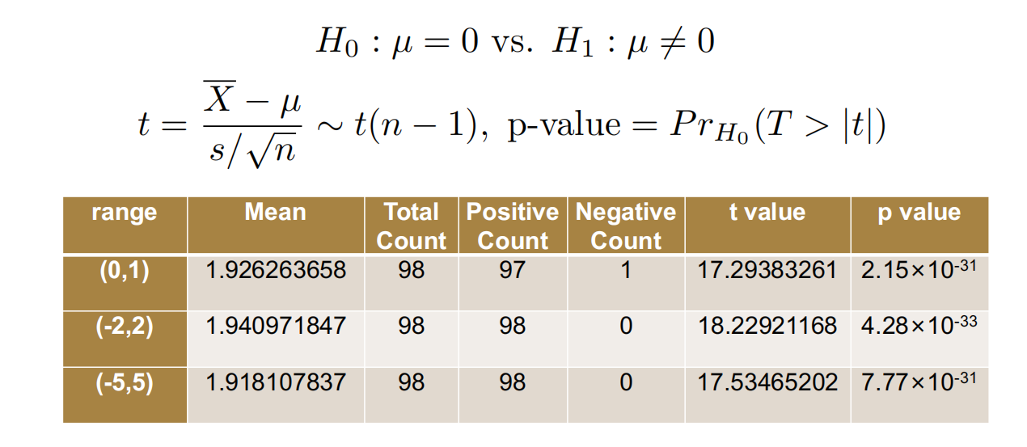
Data visualization---- Test for CAR(0, 1), CAR(-2, 2), and CAR(-5, 5)
Range | Mean | Total Count | Positive Count | Negative Count | t-value | p-value
(0,1) | 0.016666631 | 1784 | 1119 | 665 | 8.90 | 1.356594×10⁻¹⁸
(-2,2) | 0.020299145 | 1784 | 1106 | 678 | 9.37 | 2.178799×10⁻²⁰
(-5,5) | 0.021868469 | 1784 | 1094 | 690 | 9.10 | 2.305485×10⁻¹⁹
Content
Introduction
Generate normal return
Data visualization
Conclusion & Discussion

Slide 17
PART 4 Conclusion & Discussion

Slide 18
Conclusion & Discussion
Content
Introduction
Generate normal return
Data visualization
Conclusion & Discussion

Slide 19
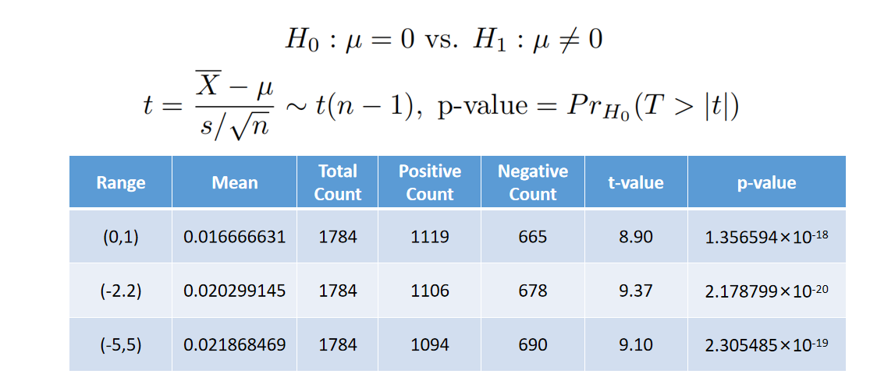
Conclusion & Discussion
Content
Introduction
Generate normal return
Data visualization
Conclusion & Discussion

Slide 20
Conclusion & Discussion---- Managerial Reasons
Why managers release dividend increasing announcements?
Insider trading
Insiders who want to grab higher profits, it is possible for them to long the target stock or portfolios in advance.
Company action
Companies purchase small amounts of shares to raise the price first and release the announcement.
Content
Introduction
Generate normal return
Data visualization
Conclusion & Discussion

Slide 21
Conclusion & Discussion---- Q&A
Q&A
Content
Introduction
Generate normal return
Data visualization
Conclusion & Discussion

Slide 22
THANKS!

